Slide 1
Session 03 Classes and Objects (http://docs.oracle.com/javase/tutorial/java/javaOO/index.html)

Slide 2
Objectives
1-Programming Paradigms
2-OOP basic concepts
3-How to identify classes
4-Hints for class design
5-How to declare/use a class
6-Common modifiers (a way to hide some members in a class)
7-Memory Management in Java (Java specs PDF)
8-Garbage Collection
9-Case study: Java program for managing a list of persons
Notes:
Modifier là gì?

Slide 3
1- Programming Paradigms
High-level programming languages (from 3rd generation languages) are divided into (Wikipedia):
Paradigm | Description
Procedural-oriented (imperative) paradigm-POP (3rd generation language) | Program= data + algorithms. Each algorithm is implemented as a function (group of statements) and data are it’s parameters (C-language)
Object-oriented paradigm (OOP) (3rd generation language) | Programs = actions of some objects. Object = data + behaviors. Each behavior is implemented as a method ( C++, Java, C#,…)
Functional paradigm (4th generation language) | Domain-specific languages. Basic functions were implemented. Programs = a set of functions ( SQL)
Declarative/Logic paradigm (5th generation language) | Program = declarations + inference rules ( Prolog, CLISP, …)

Slide 4
Programming Paradigms: POP vs. OOP
Procedure-Oriented Program
Class A
{
}
data1
data1
data2
Function1 ()
Function1 (data1)
Function2 ()
Function2 (data1)
Function3 (data2)
Function4 (data2)
Class B
{
}
Object = Data + Methods
data2
Common methods for accessing a data field:
Function3 ()
Basic Concepts
Encapsulation
Inheritance
Polymorphism
Particular methods:
Constructors
Function4()
Type getField()
void setField (Type newValue)
Notes:
Polymorphism:
Cùng tên hành vi
Nhưng lớp khác nhau thì khác nhau.

Slide 5
2-OOP Concepts
Encapsulation
Inheritance
Polymorphism

Slide 6
OOP Concepts: Encapsulation
Aggregation of data and behavior.
Class = Data (fields/properties) + Methods
Data of a class should be hidden from the outside.
All behaviors should be accessed only via methods.
A method should have a boundary condition: Parameters must be checked (use if statement) in order to assure that data of an object are always valid.
Constructor: A special method it’s code will execute when an object of this class is initialized.

Slide 7
OOP Concepts: Inheritance
Ability allows a class having members of an existed class ➔ Re-used code, save time
class PERSON
class STUDENT
ID_Num
Name
YearOfBirth
Address
getID_Num()
setID_Num(newID)
......
ID_Num
Name
YearOfBirth
Address
getID_Num()
setID_Num(newID)
......
inherited
“is a” relationship
extensions
RollNum
Score
getScore()
setSore(newScore)
......
class STUDENT
RollNum
Score
getScore()
setSore(newScore)
......
Son = Father + extensions

Slide 8
OOP Concepts: Inheritance
How to detect father class?
Finding the intersection of concerned classes.
Electric Products< code, name, make, price, guaranty, voltage, power>
Ceramic Products < code, name, make, price, type >
Food Products < code, name, make, price , date, expiredDate >
Product
code
name
make
price
Electric
Food
guaranty
voltage
power
Ceramic
date
expiredDate
type
Notes:
Mũi tên từ lớp con sang lớp cha.

Slide 9
OOP Concepts: Polymorphism
Ability allows many versions of a method based on overloading and overriding methods techniques.
Overloading: A class can have some methods which have the same name but their parameter types are different.
Overriding: A method in father class can be overridden in it’s derived classes (body of a method can be replaced in derived classes).
Notes:
Đa hình là kỹ thuật cho phép có nhiều cách thể hiện của 1 hành vi
1 tên, nhiều code

Slide 10
3- How to Identity a Class
Main noun: Class
Nouns as modifiers of main noun: Fields
Verbs related to main noun: Methods
class Student {
String code;
String name;
int bYear;
String address;
void input() {
<code>
}
void output() {
<code>
}
}
Details of a student include code, name, year of birth, address.
Write a Java program that will allow input a student, output his/her.

Slide 11
4-Hints for class design
Identifying classes: Coupling
Is an object’s reliance on knowledge of the internals of another entity’s implementation.
When object A is tightly coupled to object B, a programmer who wants to use or modify A is required to have an inappropriately extensive expertise in how to use B.
Head
High coupling
( Bad design)
Eye1
Eye2
Head
leftEye
rightEye
Eye
Eye
Low coupling
( Good design)

Slide 12
Hints for class design
Implementing methods: Cohesion is the degree to which a class or method resists being broken down into smaller pieces.
class A
M1()
{
}
M2()
{
}
M()
{ M1(); M2();
}
class A
M()
{
}
Operation 1
Operation 1
Operation 2
Operation 2
Low cohesion(bad design)
High cohesion(good design)

Slide 13
5- Declaring/Using a Java Class
[public] class ClassName [extends FatherClass] {
[modifier] Type field1 [= value];
[modifier] Type field2 [= value];
// constructor
[modifier] ClassName (Type var1,…) {
<code>
}
[modifier] Type methodName (Type var1,…) {
<code>
}
…….
}
Modifiers will be introduced later.
How many constructors should be implemented? ➔ Number of needed ways to initialize an object.
What should we will write in constructor’s body? ➔ They usually are codes for initializing values to descriptive variables

Slide 14
Defining Constructors
Constructors that are invoked to create objects from the class blueprint.
Constructor declarations look like method declarations—except that they use the name of the class and have no return type.
The compiler automatically provides a no-argument, default constructor for any class without constructors.
Notes:
This default constructor will call the no-argument constructor of the superclass. In this situation, the compiler will complain if the superclass doesn't have a no-argument constructor so you must verify that it does. If your class has no explicit superclass, then it has an implicit superclass of Object, which does have a no-argument constructor.

Slide 15
Defining Methods
Typical method declaration:
[modifier] ReturnType methodName (params) {
<code>
}
Signature: data help identifying something → Dữ liệu giúp phân biệt gọi là chữ ký.
Method Signature:
name + order of parameter types

Slide 16
Passing Arguments a Constructor/Method
Java uses the mechanism passing by value. Arguments can be:
Primitive Data Type Arguments
Reference Data Type Arguments (objects)

Slide 17
Creating Objects
Class provides the blueprint for objects; you create an object from a class.
Point p = new Point(23, 94);
Statement has three parts:
Declaration: are all variable declarations that associate a variable name with an object type.
Instantiation: The new keyword is a Java operator that creates the object (memory is allocated).
Initialization: The new operator is followed by a call to a constructor, which initializes the new object (values are assigned to fields).

Slide 18
Type of Constructors Create/Use an object of a class
Default constructor: Constructor with no parameter.
Parametric constructor: Constructor with at least one parameter.
Create an object
ClassName obj1=new ClassName();
ClassName obj2=new ClassName(params);
Accessing a field of the object
object.field
Calling a method of an object
object.method(params)

Slide 19
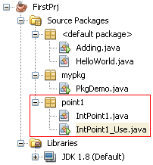
Demo: If we do not implement any constructor, compiler will insert to the class a system default constructor
In this demonstration (package point1):
The class IntPoint1 represents a point in an integral two dimensional coordinate.
The class IntPoint1_Use having the main method in which the class IntPoint1 is used.

Slide 20
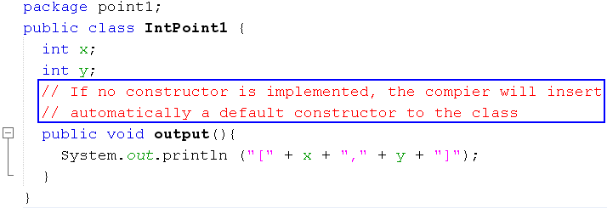
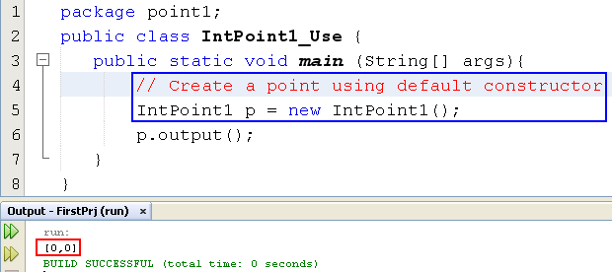
Demo: If we do not implement any constructor, compiler will insert to the class a default constructor
System constructor will clear all bits in allocated memory
Order for initializing an object
(2) Setup values
y
0
100
x
0
(1) Memory allocation
An object variable is a reference
p
100

Slide 21

Demo: If we implement a constructor, compiler does not insert default constructor
This demonstration will depict:
- The way to insert some methods automatically in NetBeans
- If user-defined constructors are implemented, compiler does not insert the system default constructor

Slide 22
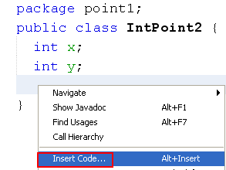
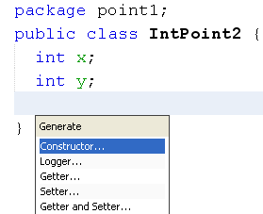
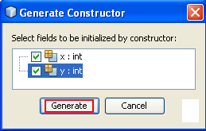
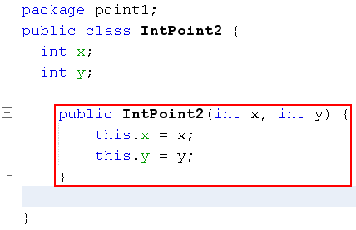
Demo: If we implement a constructor, compiler does not insert default constructor
Insert constructor
Parameter names are the same as those in declared data filed. So, the keyword this will help distinguish field name and parameter name.
this.x means that x of this object

Slide 23
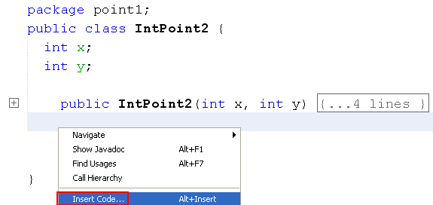
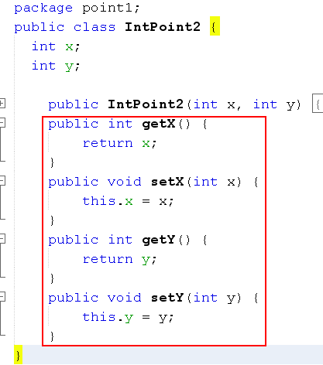
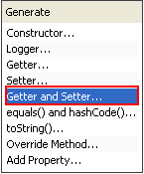
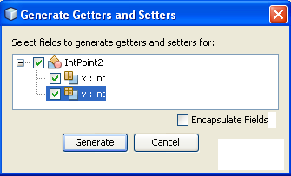
Demo: If we implement a constructor, compiler does not insert default constructor
Accessing each data field is usually supported by :
A getter for reading value of this field
A setter for modifying this field
Insert getter/setter

Slide 24
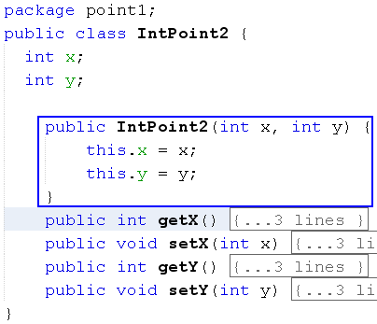
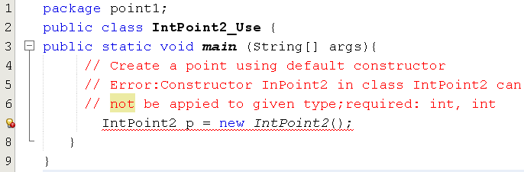
Demo: If we implement a constructor, compiler does not insert system constructor

Slide 25
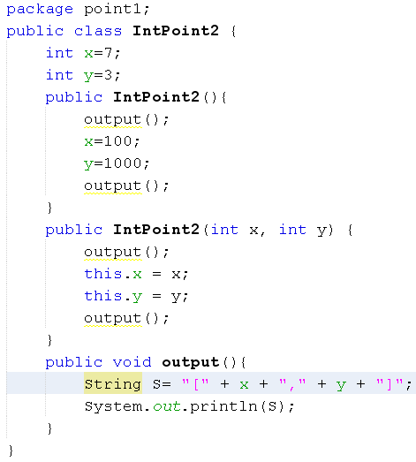
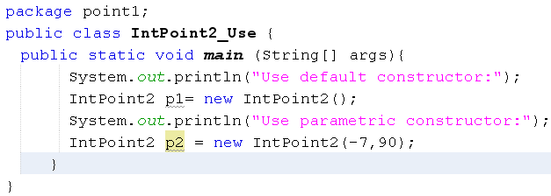
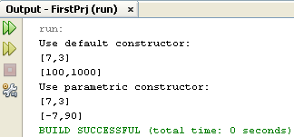
Explain the result of the following program

Slide 26
6- Common Modifiers
Modifier (linguistics)is a word which can bring out the meaning of other word (adjective →noun, adverb → verb)
Modifiers (OOP) are keywords that give the compiler information about the nature of code (methods), data, classes.
Java supports some modifiers in which some of them are common and they are called as access modifiers (public, protected, default, private).
Common modifiers will impose level of accessing on
class (where it can be used?)
methods (whether they can be called or not)
fields (whether they may be read/written or not)
Notes:
Từ định tính.
Dữ liệu có 2 tác vụ: Read/Write.
Default (ko phải từ khoá modifier → Default ở đây là ko có modifier word)

Slide 27
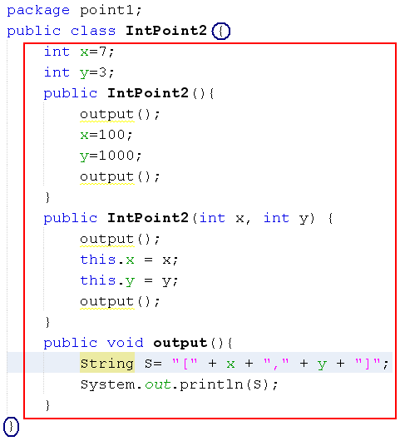
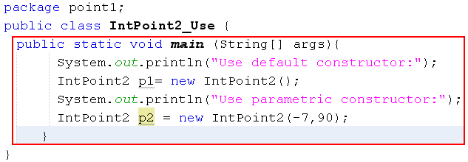
Outside of a Class
Inside of the class IntPoint2_Use and it is outside of the class IntPoint2
Inside of the class IntPoint2
Outside of the class A is another class where the class A is accessed (used)

Slide 28




Common Modifiers
Access level
Applied to
Free-accessing
public
interface
package/ subclass
protected
class
outside cannot access
private
members of
interface/class
package
no specifier
(default)
Interface is a group of prototyped methods and they will be implemented in a class afterward. It will be introduced later.
Order:
public > protected > default > private

Slide 29
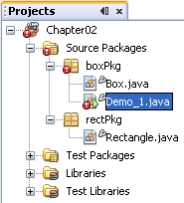
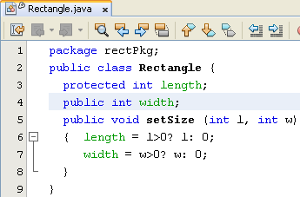
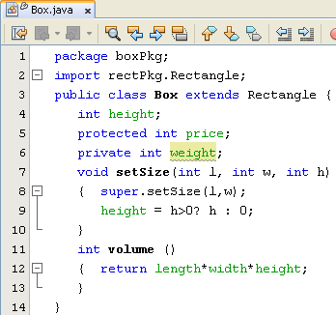
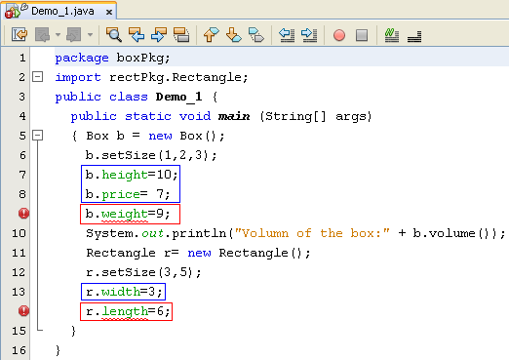
Common Modifiers
super: Keyword for calling a member declared in the father class.
If contructor of sub-class calls a constructor of it’s father using super, it must be the first statement in the sub-class constructor.
Notes:
Điều kiện biên: Là ĐK chặn dữ liệu hợp lệ

Slide 30
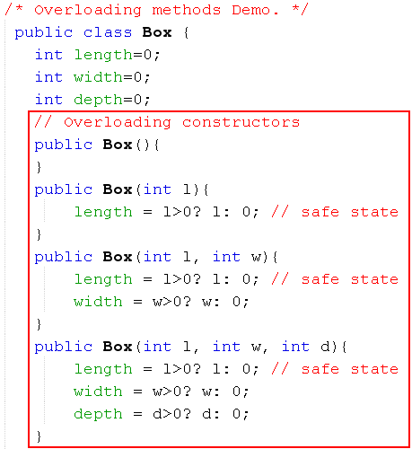
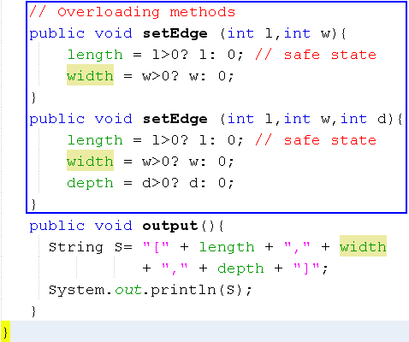
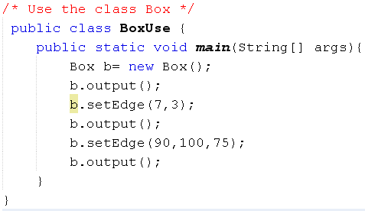

Demo: Overloading Method
Notes:
Hiểu cơ chế:
Khi new Object, JVM tự động xoá bộ nhớ.
Đoạn bên trái có thể tối ưu bằng cách ko gán trị cho properties.

Slide 31
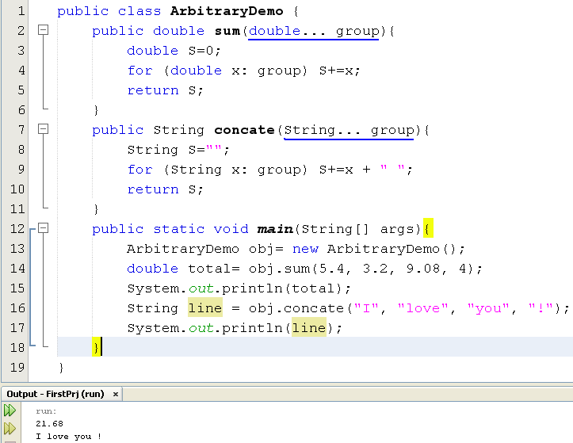
Demo: Methods with Arbitrary Number of Arguments
A group is treated as an array
group.length →number of elements
group[i]: The element at the position i
Notes:
Arbitrary: Tuỳ ý.

Slide 32
7- Memory Management in Java
Review: In C, 4 basic regions: Data segment (for global data), code segment (for statements), stack (for local data of functions when they are called), heap (for dynamic data). C/C++ programmers must explicitly manage the heap of a program.
How Java heap is managed? (Refer to: http://docs.oracle.com/javase/specs/)
JVM support the garbage collector in order to free Java programmers from explicitly managing heap
Java heap is managed by 2 lists: Free block list, Allocated block list
Initial, free block list is all the heap
After very much times for allocating and de-allocating memory, fragmented and free blocks are not contiguous

Slide 33
Memory Management in Java
How are data allocated in heap?
Way: First fit
If there is no blank block is fit, Java memory manager must compact memory in order to create more larger free block
Heap structure in Java
Static heap contains class declarations → Invariable, garbage collection is not needed
Dynamic heap is divided into two sections: The first contains objects and the second contains relations between object and appropriate method in static heap. When an object is not used (garbage), it’s memory can be de-allocated.
When an object is created, a field for reference to the class declaration is automatically added
The next slide will depict it..

Slide 34
Memory Management in Java
Class1 Definition
Constants/fields
Method table
(m1,,add1)
(m2,,add2)
m1
m2
Dynamic heap Section 2
( Entry: 2 references)
(10000, m1) → obj1.m1()
(8000, m4) → obj2.m4()
Dynamic heap
Section 1
(Garbage collection is applied)
1000
Fields
obj1:10000
(2)
500
Fields
obj2:8000
(4)
(3)
(1)
1000
Class2 definition
Constants/fields
Method table
(m3,,add3)
(m4,,add4)
m3
m4
Dynamic heap
Section 2 Relations object-method
(5) Code of m1() executes
500
Static heap
Notes:
Trình gom rác có độ ưu tiên thấp nhất
→ Chỉ gom rác khi HẾT BỘ NHỚ.

Slide 35
8- Garbage Collection
Most modern languages permit you to allocate data storage during a program run. In Java, this is done directly when you create an object with the new operation and indirectly when you call a method that has local variables or arguments.
Local data of a method include: return data, parameters, variables are declared in the body of the method.
Method locals are allocated space on the stack and are discarded when the method exits, but objects are allocated space on the heap and have a longer lifetime.

Slide 36
Garbage Collection…
In Java, you never explicitly free memory that you have allocated; instead, Java provides automatic garbage collection.
The runtime system keeps track of the memory that is allocated and is able to determine whether that memory is still useable.
Garbage collector has the lowest priority. It runs only when the system heap becomes exhausted.
A data is treated as garbage when it is out of it’s scope or an object is assigned to null.

Slide 37
Garbage Collection …
Object obj1 = new Object();
int x= 5;
if (x<10) {
Object obj2= new Object();
int y=3;
………
}
int t=7;
obj1 = null;
t*=8;
……
Scope of a variable begins at the line where it is declared and ends at the closing bracket of the block containing it
obj2, y are out of scope ( they are no longer used)
obj1= null → Memory allocated to obj1 is no longer used

Slide 38
Garbage Collection…
When does garbage collector execute?
Garbage collector has the lowest priority. So, it runs only when program’s memory is exhausted.
It is called by JVM only. We can not activate it.
Notes:
Đối tượng và tham chiếu đối tượng

Slide 39
9- Case study and Sample Report
Reports must be written in your notbook
A report includes 5 parts:
1- Problem Description
2- Analysis
3- Design
4- Implementation
5- Testing
Hereafter, a sample report is introduced.

Slide 40
Case Study 1 Report
1- Problem Description
Each person details include code, name, and age.
Write a Java program that allows users adding a new person to the list, removing a person having a known code from the list, updating details of a known-code person, listing all managed persons in descending order of ages using a simple menu.

Slide 41
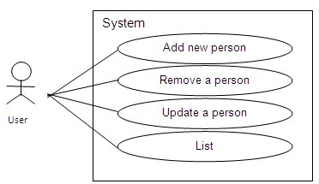
Report…
2- Analysis
From the problem description, following use-cases are identified:
System/program is expressed as a bounded rectangle.
Each function is expressed by a verb in an ellipse
User runs a function is expressed as a line

Slide 42
Report…
3- Design
3.1- Class Design
From the problem description, concepts in the problem domain are expressed by following classes:
Class Person
Description for a person
Data: String code; String name; int age
Methods: Constructors Getters, setters void input() for collecting data String toString() to get data in string format

Slide 43
Report…
Class PersonList
Description for a list of persons
Data: Person[] list; // current list int count // current number of persons
Methods: Constructors Getters, setters void add(); // add a new person. Data are collected from keyboard int find (String aCode); // Find the index of the person whose code is known void remove()// remove a person. His/ her code is accepted from keyboard void sort(); // descending sort the list based on their ages void update(); // update a person, data are accepted from keyboard void print(); // print the list

Slide 44
Report…
Class Menu
Description for a menu
Data String[] hints; // list of hints int n; // current number of hints
Methods: Menu(int n): constructor for initializing a menu containing n options void add (String aHint); // add an option int getChoice(); // get an option
Class ManagingProgram1
Description for the program
Data: none
Methods: main(…): main method of the program

Slide 45
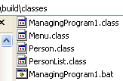
Report…
3.2- Program structure
Algorithms
Please see comments in codes.

Slide 46
Report…
3.3- User interface
Menu of the program will be seen as:
1-Add new person
2-Remove a person
3-Update a person
4-List
5-Quit

Slide 47
Report…
4- Implementation
Initial data of the program ( if any, file ………)
Please explore the software structure
Software
Please run the program
5- Testing
No. | Case | State
1 | Add new person Code: not duplicate Name: …. Age: …. | Passed Passed not passed ……
2 | Remove a person | Passed
3 | Update aperson | Passed
4 | List | ……..
… | ………………. | …..

Slide 48
Recommendations
Code Conventions:
Indentation: 4 blanks at the beginning of each code line
Comments in the code must be carried out.
Names:
One-word name: lowercase
Multi-word name: The first word: lowercase, remaining words: The first character is uppercase, others are lowercase.

Slide 49
Recommendations
A sample :
/*
Author: ……
Date: …….
This class represents ……..
*/
class ClassName ……. {
int data; // Which does data represent?
….
/* What is the goal of the method
Which does the return data represent?
*/
Method implementation ….. {
…
}
}

Slide 50
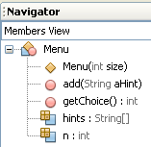

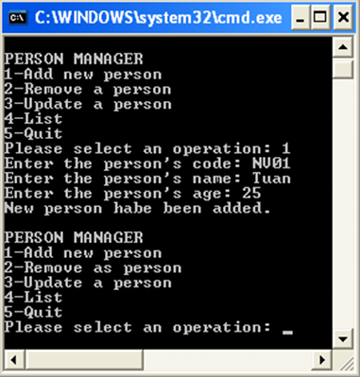
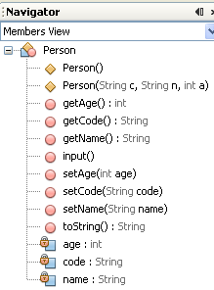
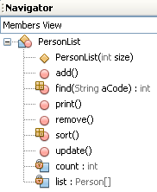
Case study: Design Guide

Slide 51
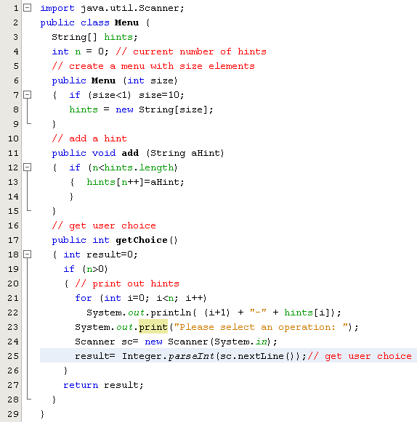
Case study: Code Supported
this: reference of the current object

Slide 52
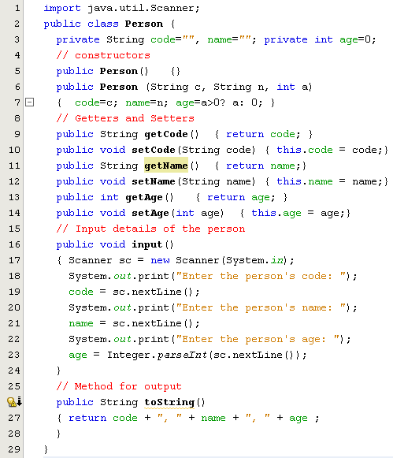
Case study: Implementation

Slide 53
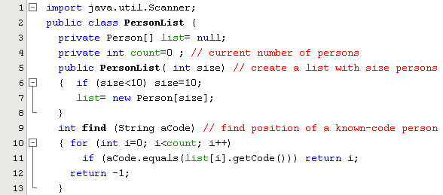
Case study: Implementation

Slide 54
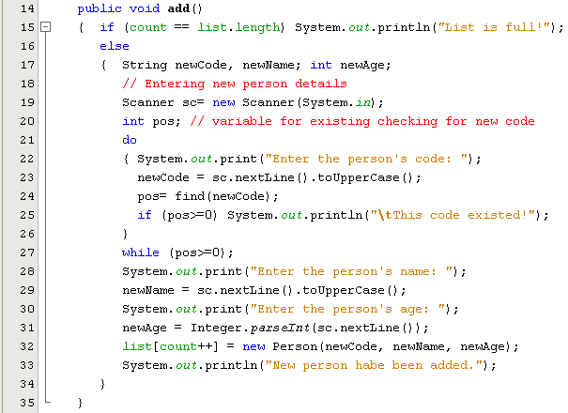
Case study: Implementation

Slide 55
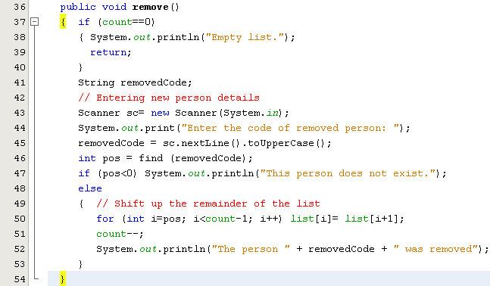
Case study: Implementation

Slide 56
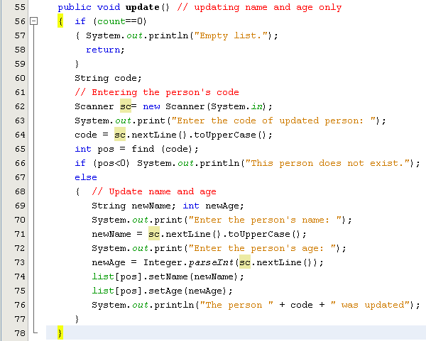
Case study: Implementation

Slide 57
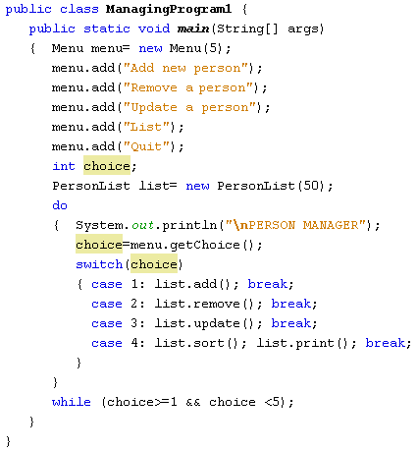
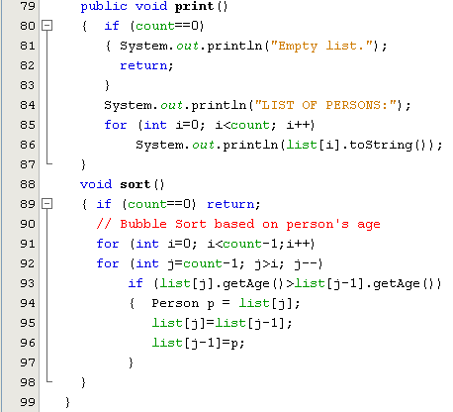
Case study: Implementation

Slide 58
Summary
The anatomy of a class, and how to declare fields, methods, and constructors.
Hints for class design:
Main noun → Class
Descriptive nouns → Fields
Methods: Constructors, Getters, Setters, Normal methods
Creating and using objects.
To instantiate an object: Using appropiate constructior
Use the dot operator to access the object's instance variables and methods.

